Slide 1
Chapter 12:
Mass-Storage Systems

Slide 2
Chapter 12: Mass-Storage Systems
Overview of Mass Storage Structure
Disk Structure
Disk Attachment
Disk Scheduling
Disk Management
Swap-Space Management
RAID Structure
Disk Attachment
Stable-Storage Implementation
Tertiary Storage Devices
Operating System Support
Performance Issues

Slide 3
Objectives
Describe the physical structure of secondary and tertiary storage devices and the resulting effects on the uses of the devices
Explain the performance characteristics of mass-storage devices
Discuss operating-system services provided for mass storage, including RAID and HSM

Slide 4
Overview of Mass Storage Structure
Magnetic disks provide bulk of secondary storage of modern computers
  Drives rotate at 60 to 200 times per second
  Transfer rate is rate at which data flow between drive and computer
  Positioning time (random-access time) is time to move disk arm to desired cylinder (seek time) and time for desired sector to rotate under the disk head (rotational latency)
  Head crash results from disk head making contact with the disk surface
    That’s bad
Disks can be removable
Drive attached to computer via I/O bus
  Busses vary, including EIDE, ATA, SATA, USB, Fibre Channel, SCSI
  Host controller in computer uses bus to talk to disk controller built into drive or storage array

Slide 5
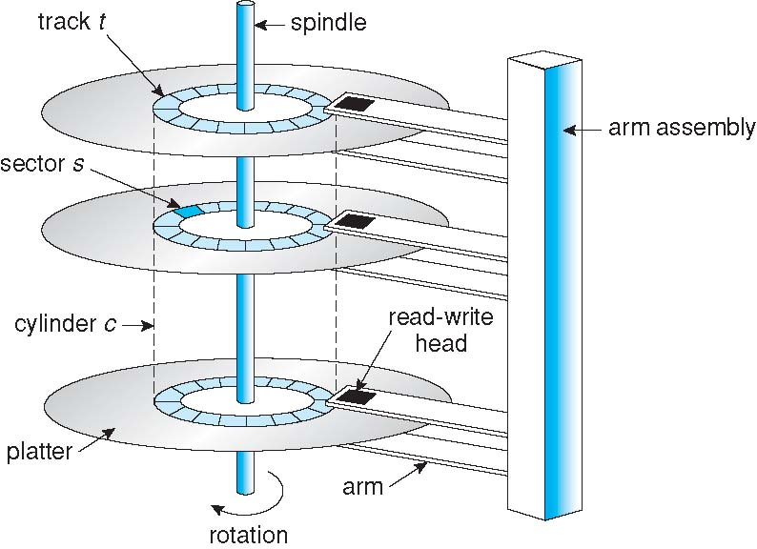
Moving-head Disk Mechanism

Slide 6
Overview of Mass Storage Structure (Cont.)
Magnetic tape
  Was early secondary-storage medium
  Relatively permanent and holds large quantities of data
  Access time slow
  Random access ~1000 times slower than disk
  Mainly used for backup, storage of infrequently-used data, transfer medium between systems
  Kept in spool and wound or rewound past read-write head
  Once data under head, transfer rates comparable to disk
  20-200GB typical storage
  Common technologies are 4mm, 8mm, 19mm, LTO-2 and SDLT

Slide 7
Disk Structure
Disk drives are addressed as large 1-dimensional arrays of logical blocks, where the logical block is the smallest unit of transfer.
The 1-dimensional array of logical blocks is mapped into the sectors of the disk sequentially.
  Sector 0 is the first sector of the first track on the outermost cylinder.
  Mapping proceeds in order through that track, then the rest of the tracks in that cylinder, and then through the rest of the cylinders from outermost to innermost.

Slide 8
Disk Attachment
Host-attached storage accessed through I/O ports talking to I/O busses
SCSI itself is a bus, up to 16 devices on one cable, SCSI initiator requests operation and SCSI targets perform tasks
  Each target can have up to 8 logical units (disks attached to device controller
Fiber Channel is high-speed serial architecture
  Can be switched fabric with 24-bit address space – the basis of storage area networks (SANs) in which many hosts attach to many storage units
  Can be arbitrated loop (FC-AL) of 126 devices

Slide 9

Network-Attached Storage
Network-attached storage (NAS) is storage made available over a network rather than over a local connection (such as a bus)
NFS and Common Internet File System are common protocols
Implemented via remote procedure calls (RPCs) between host and storage
New iSCSI protocol uses IP network to carry the SCSI protocol

Slide 10
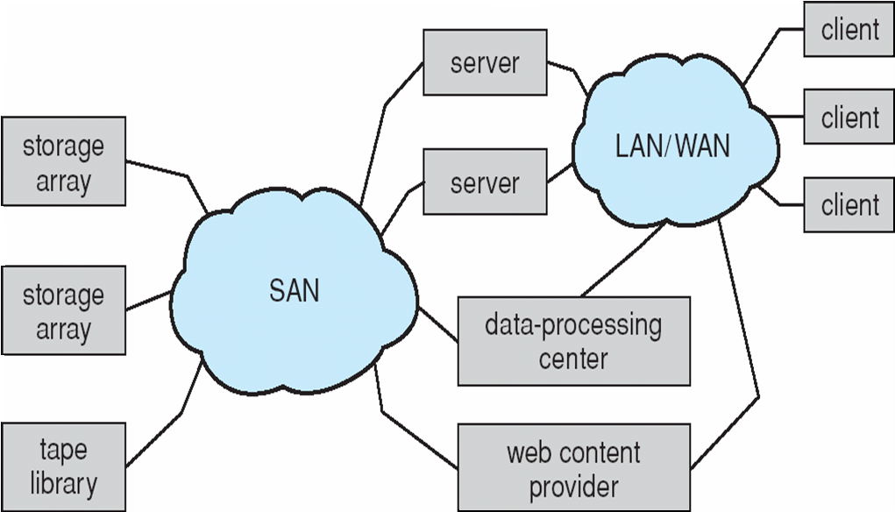
Storage Area Network
Common in large storage environments (and becoming more common)
Multiple hosts attached to multiple storage arrays - flexible

Slide 11
Disk Scheduling
The operating system is responsible for using hardware efficiently — for the disk drives, this means having a fast access time and disk bandwidth
Access time has two major components
  Seek time is the time for the disk are to move the heads to the cylinder containing the desired sector
  Rotational latency is the additional time waiting for the disk to rotate the desired sector to the disk head
Minimize seek time
Seek time ≈ seek distance
Disk bandwidth is the total number of bytes transferred, divided by the total time between the first request for service and the completion of the last transfer

Slide 12
Disk Scheduling (Cont.)
Several algorithms exist to schedule the servicing of disk I/O requests
We illustrate them with a request queue (0-199)
98, 183, 37, 122, 14, 124, 65, 67
Head pointer 53

Slide 13

FCFS
Illustration shows total head movement of 640 cylinders

Slide 14
SSTF
Selects the request with the minimum seek time from the current head position
SSTF scheduling is a form of SJF scheduling; may cause starvation of some requests
Illustration shows total head movement of 236 cylinders

Slide 15

SSTF (Cont.)

Slide 16
SCAN
The disk arm starts at one end of the disk, and moves toward the other end, servicing requests until it gets to the other end of the disk, where the head movement is reversed and servicing continues.
SCAN algorithm sometimes called the elevator algorithm
Illustration shows total head movement of 208 cylinders

Slide 17
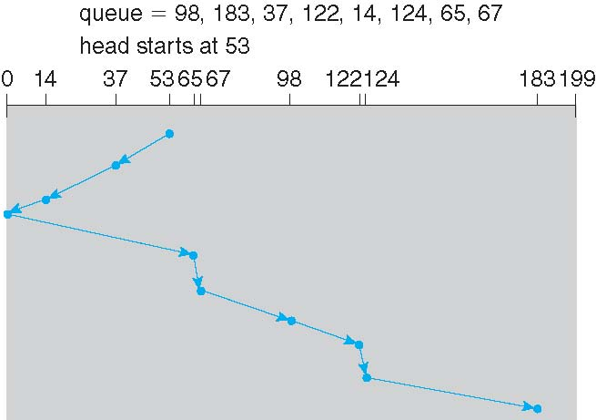
SCAN (Cont.)

Slide 18
C-SCAN
Provides a more uniform wait time than SCAN
The head moves from one end of the disk to the other, servicing requests as it goes
  When it reaches the other end, however, it immediately returns to the beginning of the disk, without servicing any requests on the return trip
Treats the cylinders as a circular list that wraps around from the last cylinder to the first one

Slide 19

C-SCAN (Cont.)

Slide 20
C-LOOK
Version of C-SCAN
Arm only goes as far as the last request in each direction, then reverses direction immediately, without first going all the way to the end of the disk

Slide 21

C-LOOK (Cont.)

Slide 22
Selecting a Disk-Scheduling Algorithm
SSTF is common and has a natural appeal.
SCAN and C-SCAN perform better for systems that place a heavy load on the disk.
Performance depends on the number and types of requests.
Requests for disk service can be influenced by the file-allocation method.
The disk-scheduling algorithm should be written as a separate module of the operating system, allowing it to be replaced with a different algorithm if necessary.
Either SSTF or LOOK is a reasonable choice for the default algorithm.

Slide 23
Disk Management
Low-level formatting, or physical formatting — Dividing a disk into sectors that the disk controller can read and write
To use a disk to hold files, the operating system still needs to record its own data structures on the disk
  Partition the disk into one or more groups of cylinders
  Logical formatting or “making a file system”
  To increase efficiency most file systems group blocks into clusters
    Disk I/O done in blocks
    File I/O done in clusters
Boot block initializes system
  The bootstrap is stored in ROM
  Bootstrap loader program
Methods such as sector sparing used to handle bad blocks

Slide 24

Booting from a Disk in Windows 2000

Slide 25
Swap-Space Management
Swap-space — Virtual memory uses disk space as an extension of main memory
Swap-space can be carved out of the normal file system, or, more commonly, it can be in a separate disk partition
Swap-space management
  4.3BSD allocates swap space when process starts; holds text segment (the program) and data segment
  Kernel uses swap maps to track swap-space use
  Solaris 2 allocates swap space only when a page is forced out of physical memory, not when the virtual memory page is first created

Slide 26
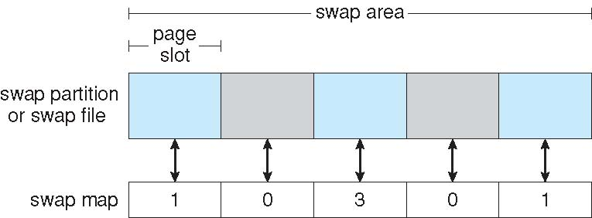
Data Structures for Swapping on
Linux Systems

Slide 27
RAID Structure
RAID – multiple disk drives provides reliability via redundancy
Increases the mean time to failure
Frequently combined with NVRAM to improve write performance
RAID is arranged into six different levels

Slide 28
RAID (Cont.)
Several improvements in disk-use techniques involve the use of multiple disks working cooperatively.
Disk striping uses a group of disks as one storage unit.
RAID schemes improve performance and improve the reliability of the storage system by storing redundant data.
  Mirroring or shadowing (RAID 1) keeps duplicate of each disk.
  Striped mirrors (RAID 1+0) or mirrored stripes (RAID 0+1) provides high performance and high reliability.
  Block interleaved parity (RAID 4, 5, 6) uses much less redundancy.
RAID within a storage array can still fail if the array fails, so automatic replication of the data between arrays is common.
Frequently, a small number of hot-spare disks are left unallocated, automatically replacing a failed disk and having data rebuilt onto them.

Slide 29
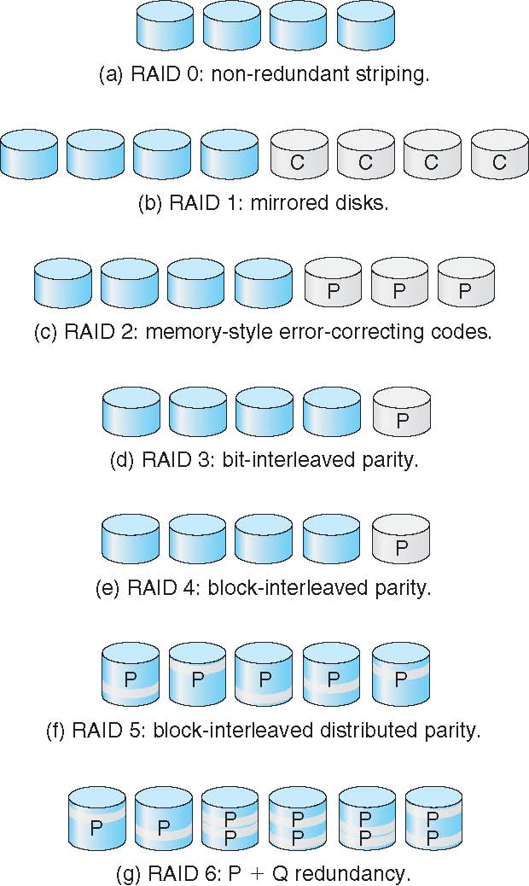
RAID Levels

Slide 30
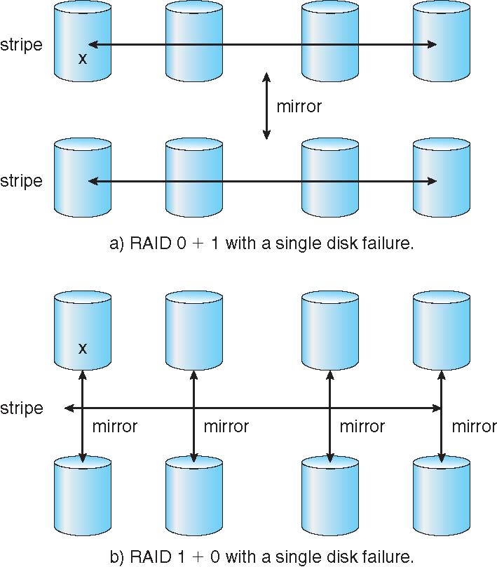
RAID (0 + 1) and (1 + 0)

Slide 31
Extensions
RAID alone does not prevent or detect data corruption or other errors, just disk failures.
Solaris ZFS adds checksums of all data and metadata.
Checksums kept with pointer to object, to detect if object is the right one and whether it changed.
Can detect and correct data and metadata corruption
ZFS also removes volumes, partititions
  Disks allocated in pools
  Filesystems with a pool share that pool,
  use and release space like “malloc” and “free” memory allocate / release calls
The Z file system, originally developed by Sun™, is designed to use a pooled storage method in that space is only used as it is needed for data storage. It is also designed for maximum data integrity, supporting data snapshots, multiple copies, and data checksums. It uses a software data replication model, known as RAID-Z. RAID-Z provides redundancy similar to hardware RAID, but is designed to prevent data write corruption and to overcome some of the limitations of hardware RAID

Slide 32
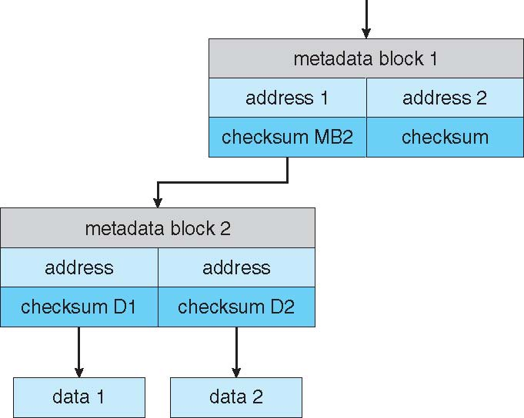
ZFS Checksums All Metadata and Data

Slide 33
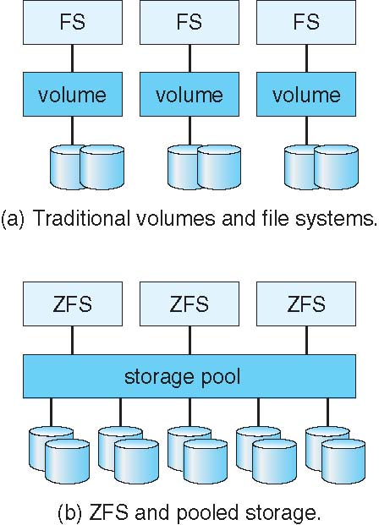
Traditional and Pooled Storage

Slide 34
Stable-Storage Implementation
Write-ahead log scheme requires stable storage.
To implement stable storage:
  Replicate information on more than one nonvolatile storage media with independent failure modes.
  Update information in a controlled manner to ensure that we can recover the stable data after any failure during data transfer or recovery.

Slide 35
Tertiary Storage Devices
Low cost is the defining characteristic of tertiary storage
Generally, tertiary storage is built using removable media
Common examples of removable media are floppy disks and CD-ROMs; other types are available

Slide 36
Removable Disks
Floppy disk — thin flexible disk coated with magnetic material, enclosed in a protective plastic case
  Most floppies hold about 1 MB; similar technology is used for removable disks that hold more than 1 GB
  Removable magnetic disks can be nearly as fast as hard disks, but they are at a greater risk of damage from exposure

Slide 37
Removable Disks (Cont.)
A magneto-optic disk records data on a rigid platter coated with magnetic material.
  Laser heat is used to amplify a large, weak magnetic field to record a bit.
  Laser light is also used to read data (Kerr effect).
  The magneto-optic head flies much farther from the disk surface than a magnetic disk head, and the magnetic material is covered with a protective layer of plastic or glass; resistant to head crashes.
Optical disks do not use magnetism; they employ special materials that are altered by laser light.

Slide 38
WORM Disks
The data on read-write disks can be modified over and over.
WORM (“Write Once, Read Many Times”) disks can be written only once.
Thin aluminum film sandwiched between two glass or plastic platters.
To write a bit, the drive uses a laser light to burn a small hole through the aluminum; information can be destroyed by not altered.
Very durable and reliable
Read-only disks, such ad CD-ROM and DVD, com from the factory with the data pre-recorded.

Slide 39
Tapes
Compared to a disk, a tape is less expensive and holds more data, but random access is much slower.
Tape is an economical medium for purposes that do not require fast random access, e.g., backup copies of disk data, holding huge volumes of data.
Large tape installations typically use robotic tape changers that move tapes between tape drives and storage slots in a tape library
  stacker – library that holds a few tapes
  silo – library that holds thousands of tapes
A disk-resident file can be archived to tape for low cost storage; the computer can stage it back into disk storage for active use.

Slide 40
Operating System Support
Major OS jobs are to manage physical devices and to present a virtual machine abstraction to applications.
For hard disks, the OS provides two abstraction:
  Raw device – an array of data blocks
  File system – the OS queues and schedules the interleaved requests from several applications

Slide 41
Application Interface
Most OSs handle removable disks almost exactly like fixed disks — a new cartridge is formatted and an empty file system is generated on the disk.
Tapes are presented as a raw storage medium, i.e., and application does not not open a file on the tape, it opens the whole tape drive as a raw device.
Usually the tape drive is reserved for the exclusive use of that application.
Since the OS does not provide file system services, the application must decide how to use the array of blocks.
Since every application makes up its own rules for how to organize a tape, a tape full of data can generally only be used by the program that created it.

Slide 42
Tape Drives
The basic operations for a tape drive differ from those of a disk drive.
locate()positions the tape to a specific logical block, not an entire track (corresponds to seek()).
The read position()operation returns the logical block number where the tape head is.
The space() operation enables relative motion.
Tape drives are “append-only” devices; updating a block in the middle of the tape also effectively erases everything beyond that block.
An EOT mark is placed after a block that is written.

Slide 43
File Naming
The issue of naming files on removable media is especially difficult when we want to write data on a removable cartridge on one computer, and then use the cartridge in another computer.
Contemporary OSs generally leave the name space problem unsolved for removable media, and depend on applications and users to figure out how to access and interpret the data.
Some kinds of removable media (e.g., CDs) are so well standardized that all computers use them the same way.

Slide 44
Hierarchical Storage Management (HSM)
A hierarchical storage system extends the storage hierarchy beyond primary memory and secondary storage to incorporate tertiary storage — usually implemented as a jukebox of tapes or removable disks
Usually incorporate tertiary storage by extending the file system
  Small and frequently used files remain on disk
  Large, old, inactive files are archived to the jukebox
HSM is usually found in supercomputing centers and other large installations that have enormous volumes of data

Slide 45
Speed
Two aspects of speed in tertiary storage are bandwidth and latency.
Bandwidth is measured in bytes per second.
  Sustained bandwidth – average data rate during a large transfer; # of bytes/transfer time
  Data rate when the data stream is actually flowing
  Effective bandwidth – average over the entire I/O time, including seek() or locate(), and cartridge switching
  Drive’s overall data rate

Slide 46
Speed (Cont.)
Access latency – amount of time needed to locate data
  Access time for a disk – move the arm to the selected cylinder and wait for the rotational latency; < 35 milliseconds.
  Access on tape requires winding the tape reels until the selected block reaches the tape head; tens or hundreds of seconds.
  Generally say that random access within a tape cartridge is about a thousand times slower than random access on disk.
The low cost of tertiary storage is a result of having many cheap cartridges share a few expensive drives.
A removable library is best devoted to the storage of infrequently used data, because the library can only satisfy a relatively small number of I/O requests per hour.

Slide 47
Reliability
A fixed disk drive is likely to be more reliable than a removable disk or tape drive.
An optical cartridge is likely to be more reliable than a magnetic disk or tape.
A head crash in a fixed hard disk generally destroys the data, whereas the failure of a tape drive or optical disk drive often leaves the data cartridge unharmed.

Slide 48
Cost
Main memory is much more expensive than disk storage.
The cost per megabyte of hard disk storage is competitive with magnetic tape if only one tape is used per drive.
The cheapest tape drives and the cheapest disk drives have had about the same storage capacity over the years.
Tertiary storage gives a cost savings only when the number of cartridges is considerably larger than the number of drives.

Slide 49
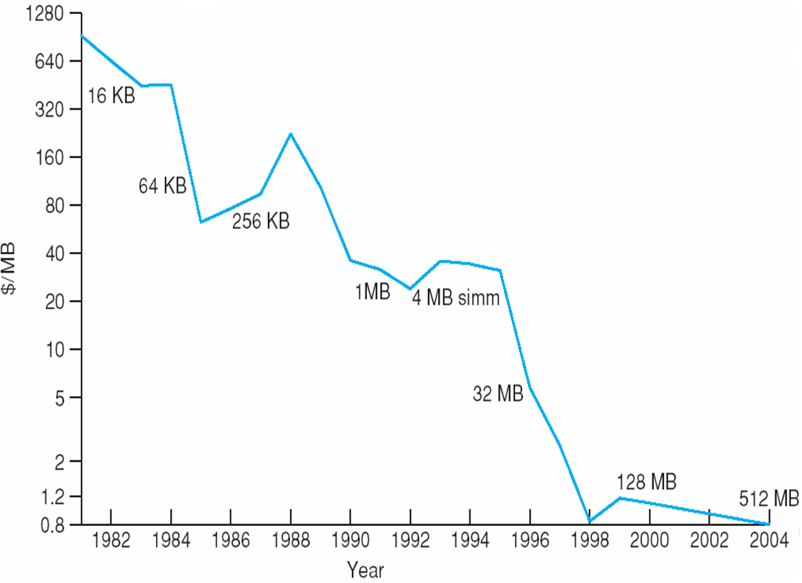
Price per Megabyte of DRAM
From 1981 to 2004

Slide 50
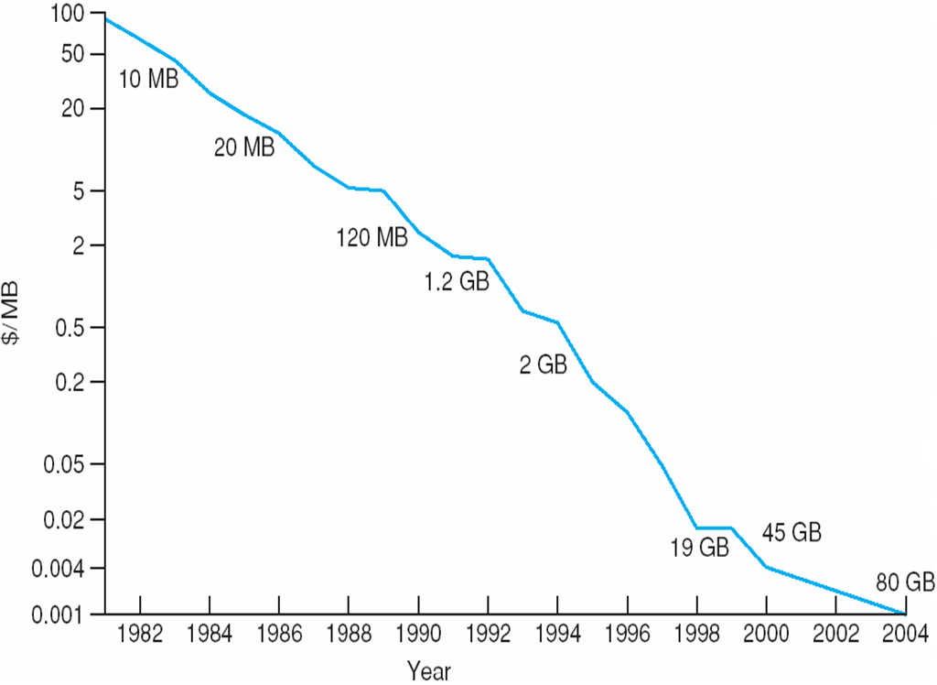
Price per Megabyte of Magnetic Hard Disk
From 1981 to 2004

Slide 51
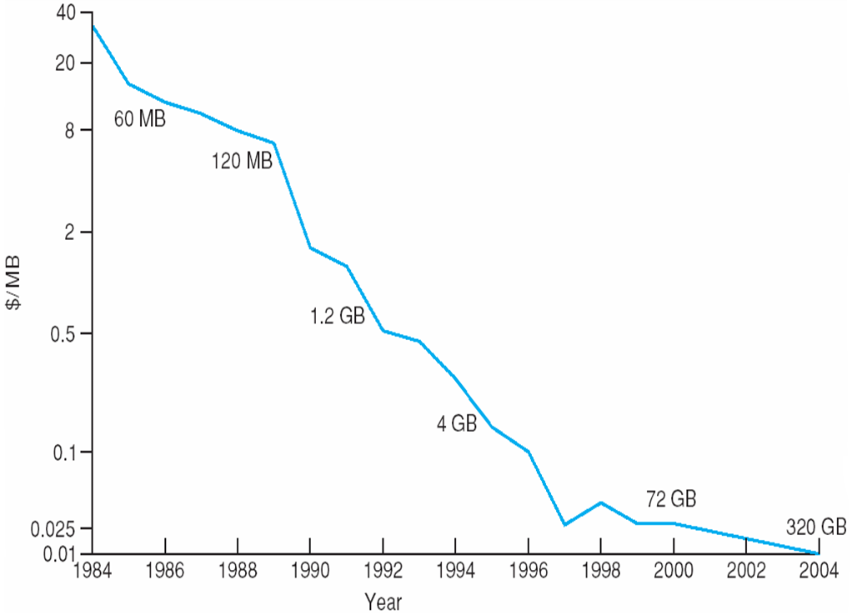
Price per Megabyte of a Tape Drive
From 1984-2000

Slide 52
End of Chapter 12

